Slide 1
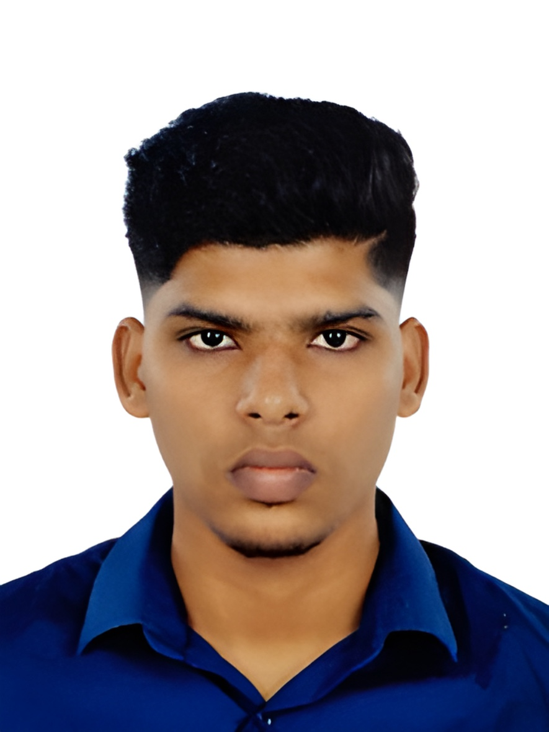

Student Details
name : sagar v
RRN: 220071601212
SKILLBUILD EMAIL-iD : imsagar017@gmail.com
SKILLBUILD UNDER: dgt
College name : b s abdur rahman crescent institute of science and technology
College state : Tamil nadu
AICTE INTERNSHIP STUDENT REGISTRATION ID : STU666d367655ff81718433398

Slide 2
PROJECT TITLE/Problem Statement
Project Title:
Netflix-clone
Problem Statement:
The objective of this project is to create a clone of NETFLIX website using CSS and HTML . The clone should replicate the layout and design of NETFLIX’s homepage, including the navigation bar, search bar, and other key elements. The project aims to enhance skills in front-end web development, particularly in using HTML for structure and CSS for responsive design and styling.
one of the favourite and best streaming service website but user faces some difficulties facing on Signing-in or creating account
Create a mini NETFLIX clone app that allows users to browse and search for movies, TV shows, Documentaries and Biography. The app should include the following features
Home Page: Display a list of popular movies and TV shows.
Search Functionality: Allow users to search for movies, TV shows, Documentaries and Biography.
Brief information : It shows a brief statement on how to watch movies or series in NETFLIX , how to where to watch any series or movies and there is section for kids which is dedicated for kids .
Frequently Asked Question : Display information about the question that have been asked and query made by most of the Customers or Reviewers about NETFLIX
Responsive Design: Ensure the website is fully responsive and works well on different devices (desktops, tablets, and mobile phones).
Technical Requirement :
front end web development
Use Reactjs , CSS and HTML for the front-end design.

Slide 3
AGENDA
1. Introduction
- Overview of the Netflix Clone Project
- Objectives and Goals
2. Project Scope
- Key Features to Implement
- Technical Requirements
3. Design and Layout
- User Interface Design
- Replicating Netflix’s Layout and Design
4. Development Process
- Using HTML for Structure
- Using CSS for Styling and Responsive Design
5. Key Features
- Header Netflix logo, navigation links, search bar, user profile
- Hero Section Featured content with title, description, and action buttons
- Content Sections Rows of thumbnails for categories like Trending, Top Picks, and My List
- Footer Links to help, terms of service, and social media

Slide 4
PROJECT OVERVIEW
Project Overview
Header: The top section will include the Netflix logo, navigation links, a search bar, and a user profile icon to replicate Netflix's familiar layout.
Hero Section : This section will feature highlighted content with a prominent title, description, and action buttons to engage users.
Content Sections : Multiple rows of thumbnails will showcase various categories like Trending, Top Picks, and My List, providing users with an easy way to browse through different types of content.
Footer : The bottom section will provide links to help pages, terms of service, and social media, ensuring users have access to important information and can connect with Netflix on different platforms.
This project demonstrates how to create a visually appealing and user-friendly web layout, with an emphasis on styling and responsive design using HTML and CSS.

Slide 5
WHO ARE THE END USERS of this project?
End Users
The end users of this Netflix clone project are primarily
1. Potential Employers or Clients
- To showcase your front-end development skills and proficiency in creating a complex, visually appealing web application.
2. Developers and Designers
- For learning or referencing HTML and CSS techniques, and for understanding how to structure and style a web application effectively.
3. Students and Educators
- For teaching and learning web development concepts, providing a practical example of a real-world application to enhance educational experiences.
4. Hobbyists and Enthusiasts
- For exploring web development as a hobby or interest, allowing them to experiment with and practice their skills in a fun and engaging way.

Slide 6
YOUR SOLUTION AND ITS VALUE PROPOSITION
Solution:
The project aims to develop a Netflix clone website using HTML and CSS, replicating the design and functionality of Netflix's homepage. This includes key components such as the header, hero section, content sections, and footer, ensuring a user-friendly and visually appealing layout.
Value Proposition :
1. Skill Demonstration :
- For Job Seekers Showcases your expertise in front-end development, making you a more attractive candidate to potential employers or clients.
- For Developers and Designers Provides a reference project demonstrating advanced HTML and CSS techniques, enhancing your skill set.
2. Educational Tool :
- For Students Offers a practical example to reinforce learning of web development concepts.
- For Educators Serves as a teaching aid to explain the application of HTML and CSS in a real-world scenario.
3. Learning and Exploration :
- For Hobbyists Allows you to explore web development, practice your skills, and gain hands-on experience in creating a complex web application.

Slide 7
4. Responsive Design :
- Ensures the website works seamlessly across different devices, providing a consistent user experience on desktops, tablets, and mobile phones.
5. User Experience :
- For All Users Delivers a user-friendly interface that mirrors Netflix’s design, making navigation intuitive and content easily accessible.
6. Comprehensive Content :
- For All Users Offers organized content sections with clear categorization, enhancing content discovery and engagement.
By creating this Netflix clone, you not only develop a visually appealing and functional website but also gain valuable experience in front-end web development, positioning yourself as a skilled developer in the competitive job market.

Slide 8
How did you customize the project and make it your own
Unique Design Elements
Added personal design touches to the layout, such as custom color schemes, typography, and icons, to differentiate the clone from the original Netflix design while maintaining a professional look.
Enhanced Features
implemented additional features like hover effects on thumbnails, animated transitions for a smoother user experience, and personalized hero section content.
Original Content
Curated a unique selection of movies and TV shows for the content sections, providing a fresh perspective and ensuring the clone reflects personal tastes and creativity.
Improved User Interface
Enhanced the user interface with intuitive navigation, interactive elements like clickable content cards that lead to detailed information pages, and a customized footer with personalized links and social media integration.
Content Customization
Included sections like "My List" where users can save their favorite content, providing a personalized touch and enhancing user engagement.
Detailed Pages
Created detailed information pages for each movie and TV show, complete with custom descriptions, release dates, ratings, and more, offering users comprehensive content insights.

Slide 9
MODELLING
1. Wireframing :
- Created rough sketches and digital wireframes to outline the basic layout and structure, ensuring logical content flow.
2. Prototyping :
- Developed an interactive prototype to simulate user interactions and gather feedback for refinement.
3. Component Design :
- Designed reusable components (Navbar, HeroSection, ContentCard, Footer) and applied consistent CSS styling for visual appeal.
4. Responsive Design:
- Used media queries, fluid grids, and Flexbox layouts to ensure the website adapts seamlessly to various screen sizes.
5. Data Modelling :
- Structured content data for movies and TV shows, and used React's state management for dynamic content rendering and user interactions.
6. Routing:
- Implemented React Router for seamless navigation and utilized route parameters for detailed information pages.
7. User Interface Modelling :
- Added user profile features and search functionality to enhance personalization and usability.
8. Performance Optimization :
- Applied lazy loading and code splitting to optimize loading times and performance.
9. Testing and Validation :
- Conducted cross-browser and user testing to ensure consistent performance and user satisfaction.

Slide 10
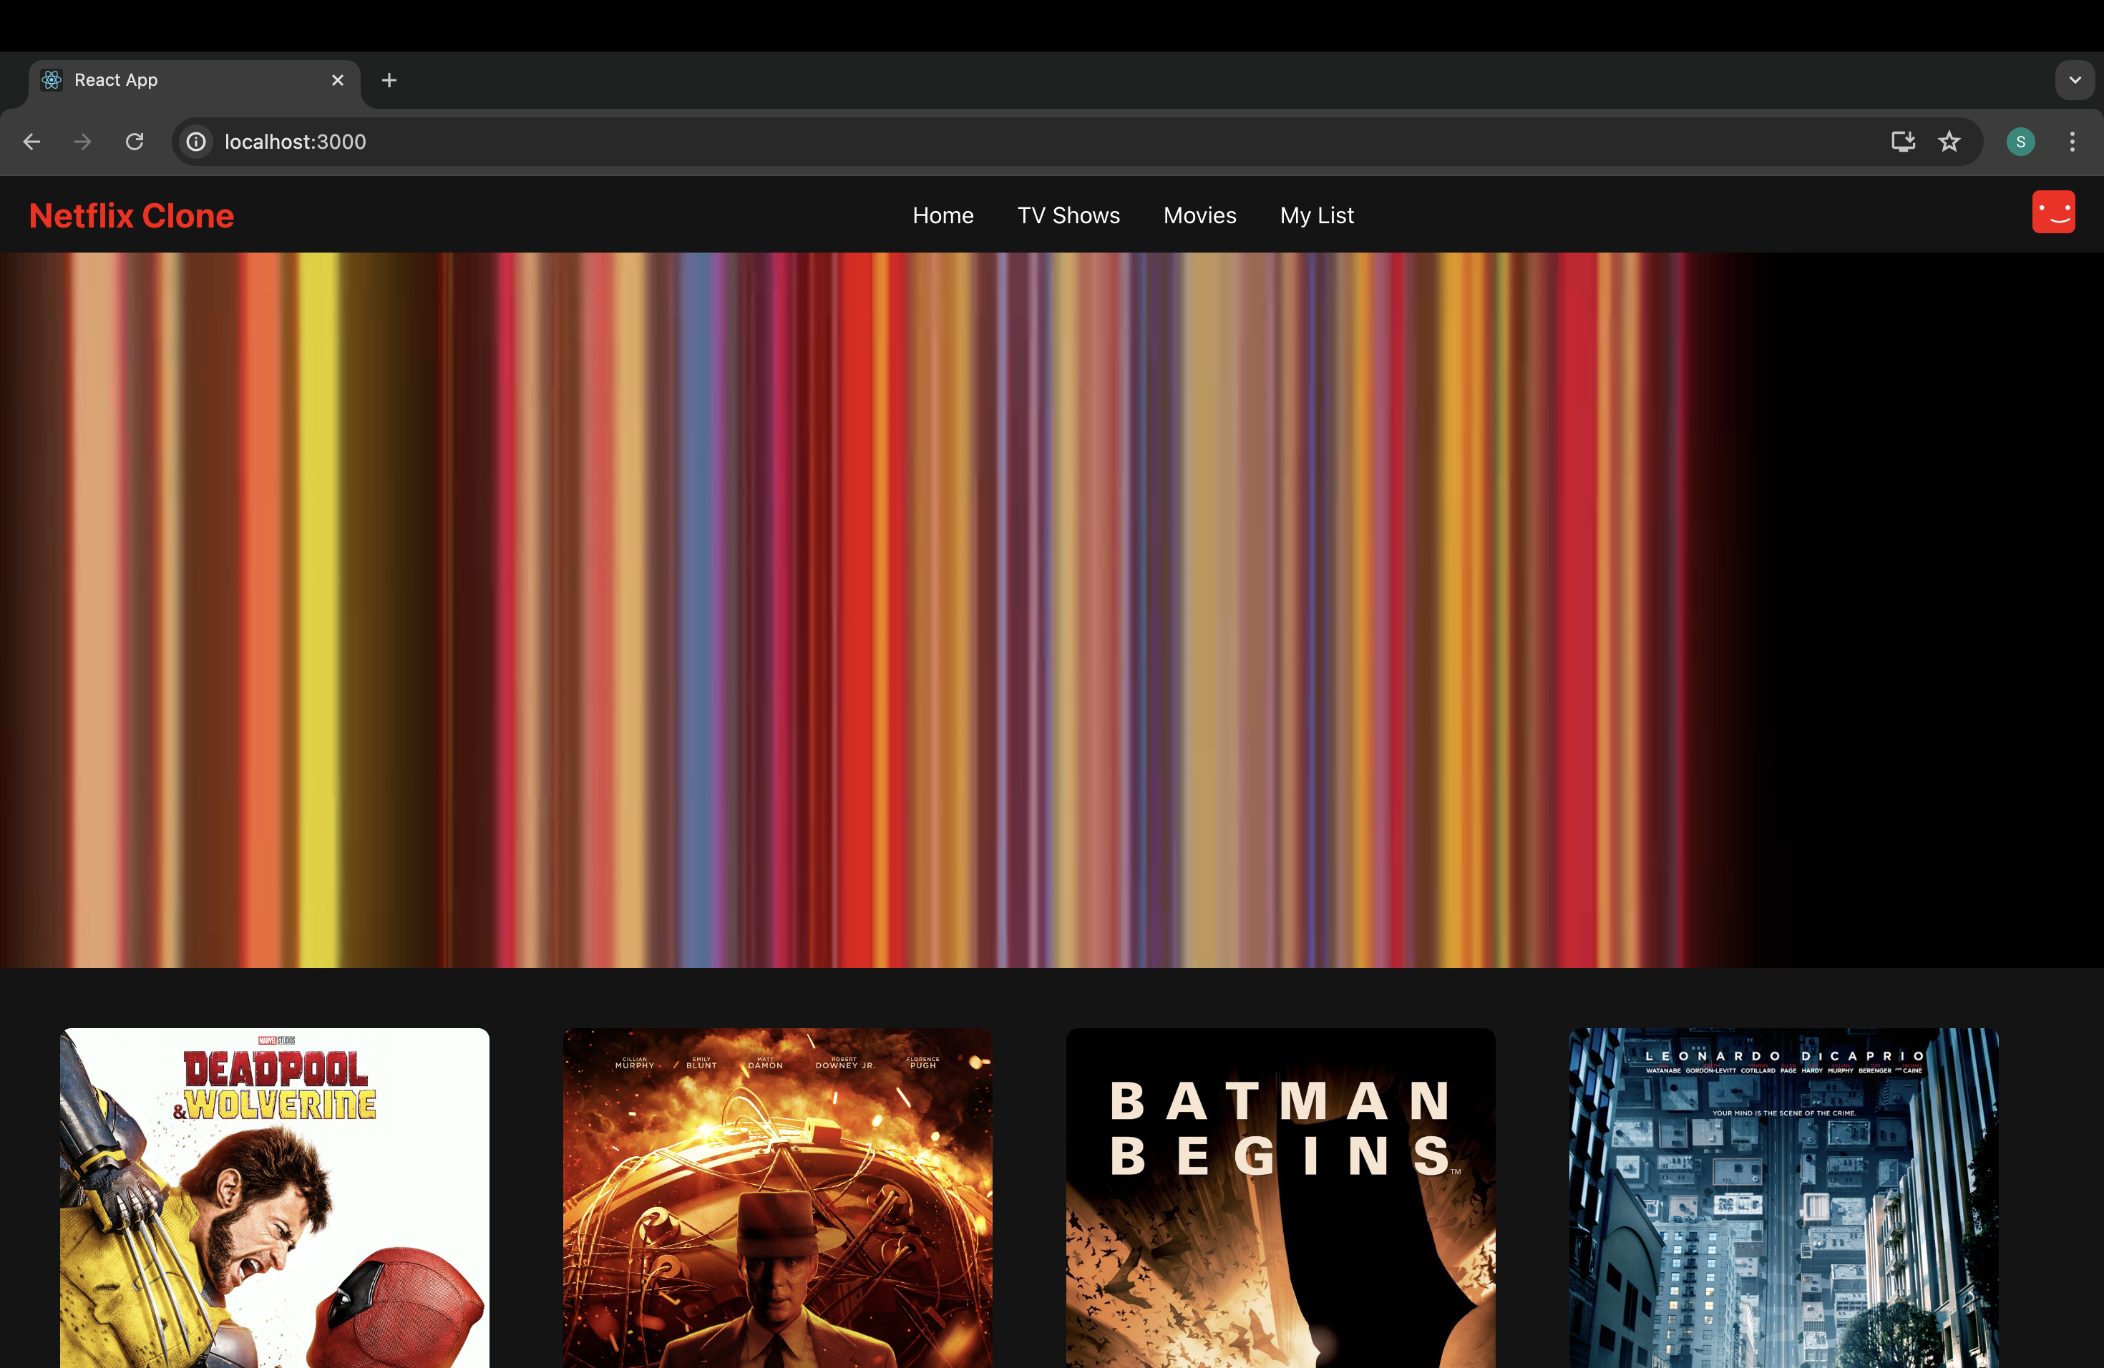
Results

Slide 11
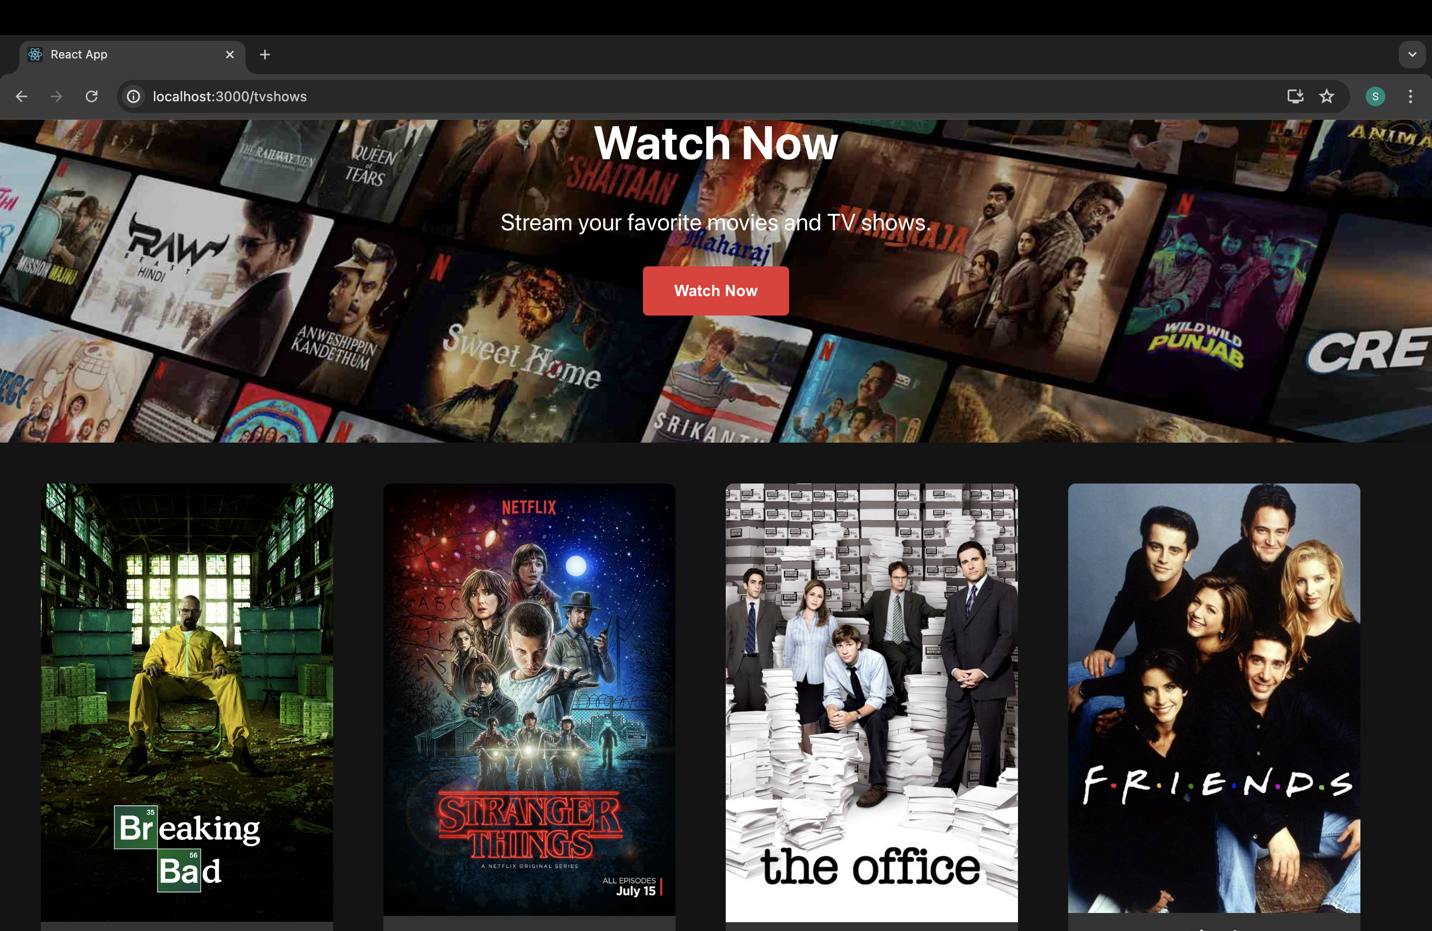

Slide 12
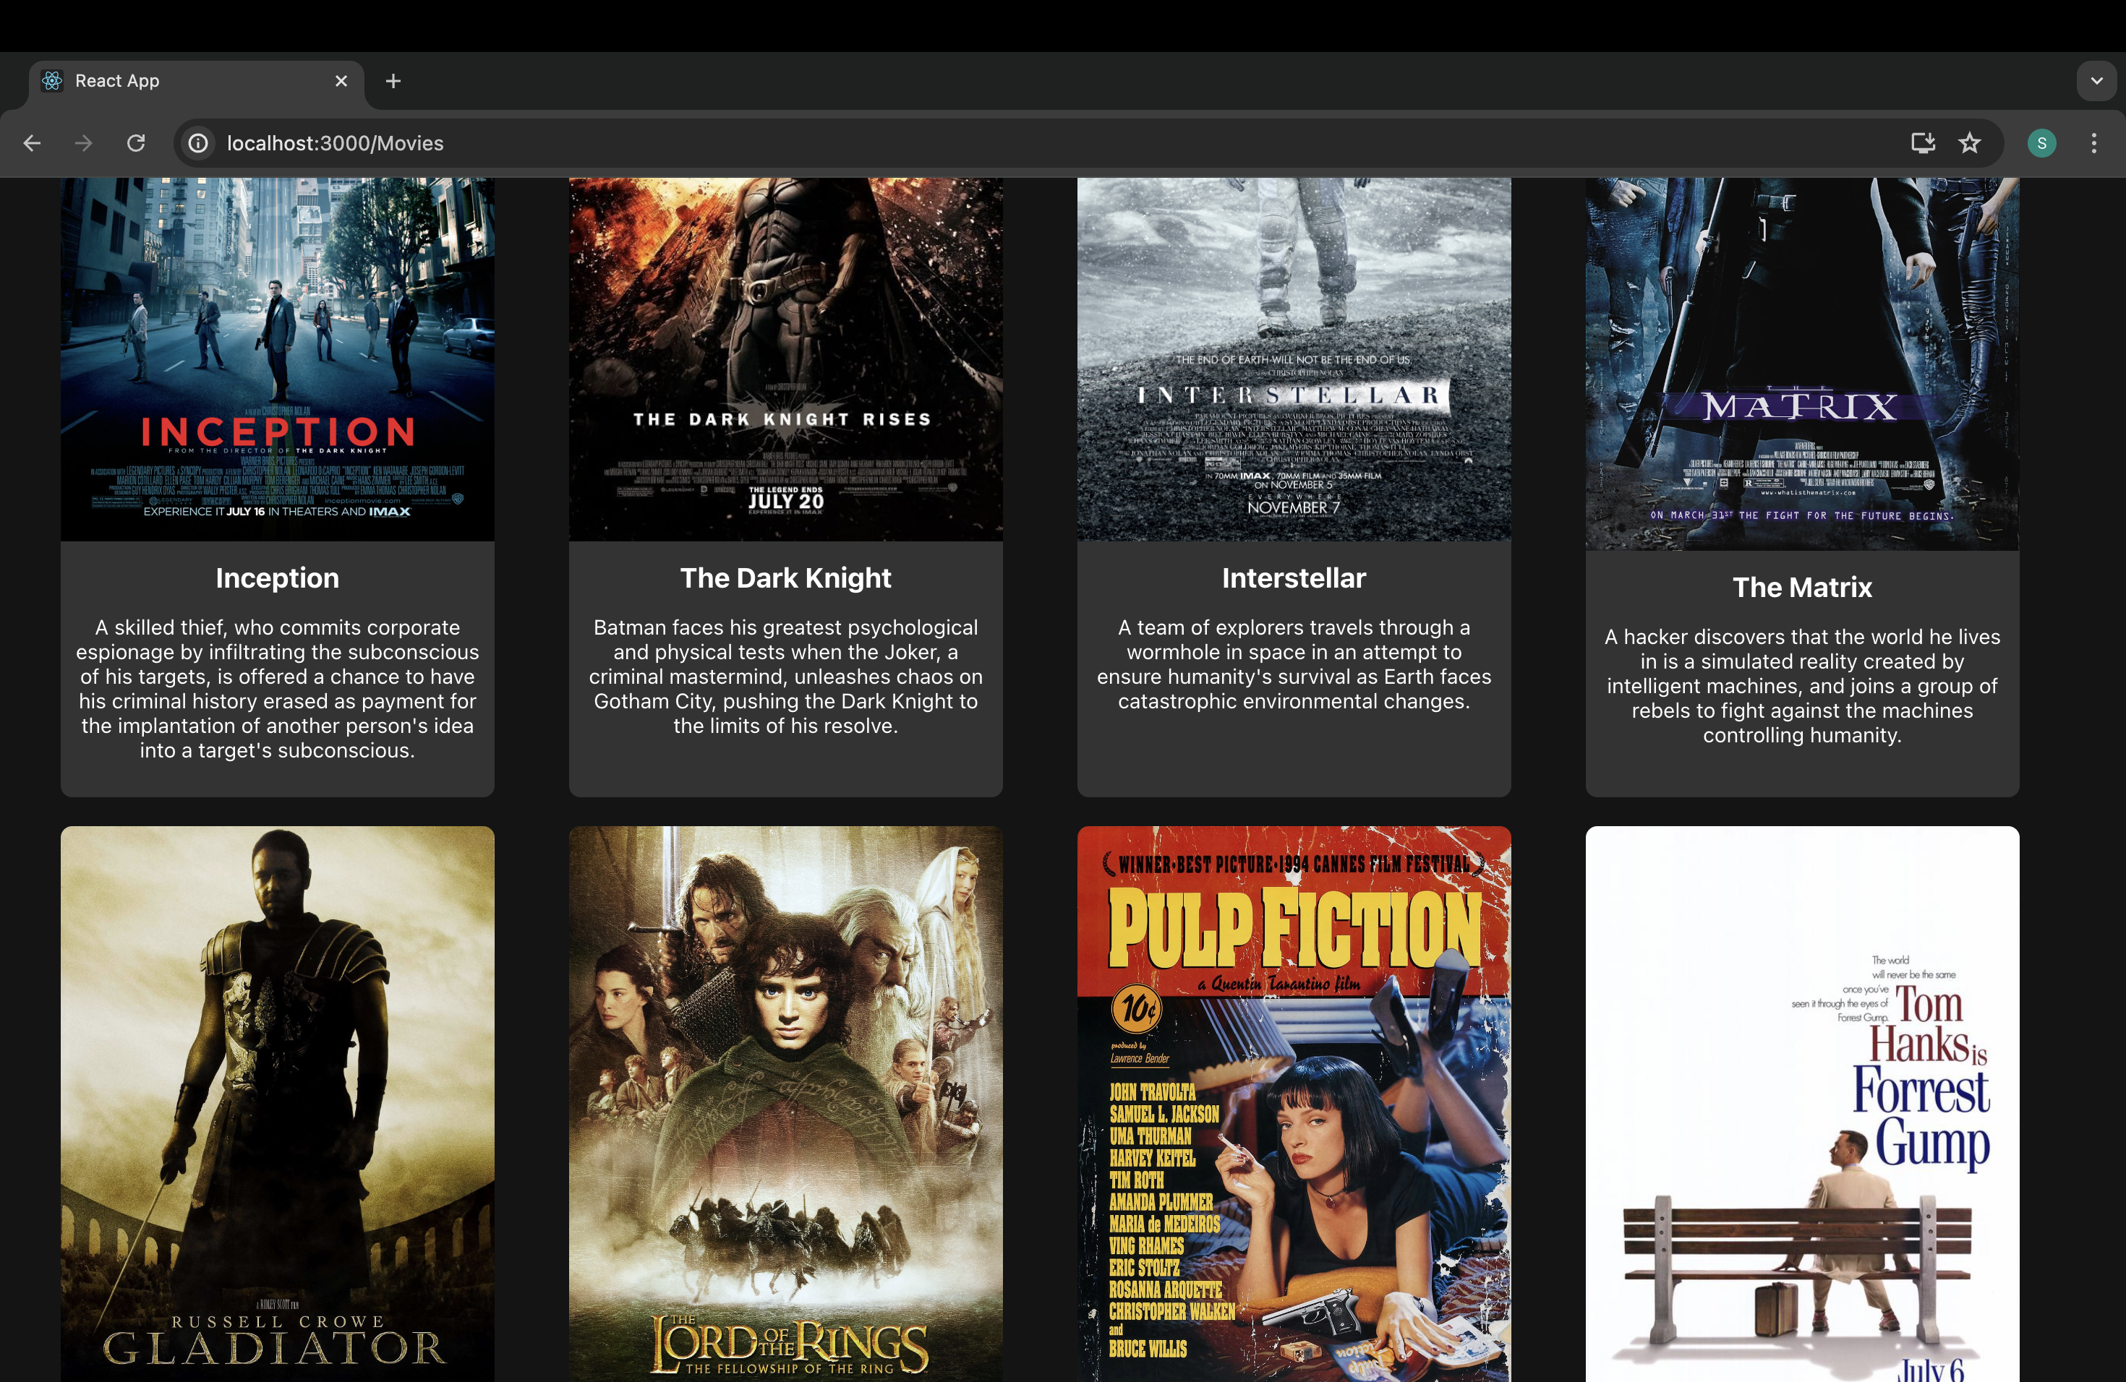

Slide 13
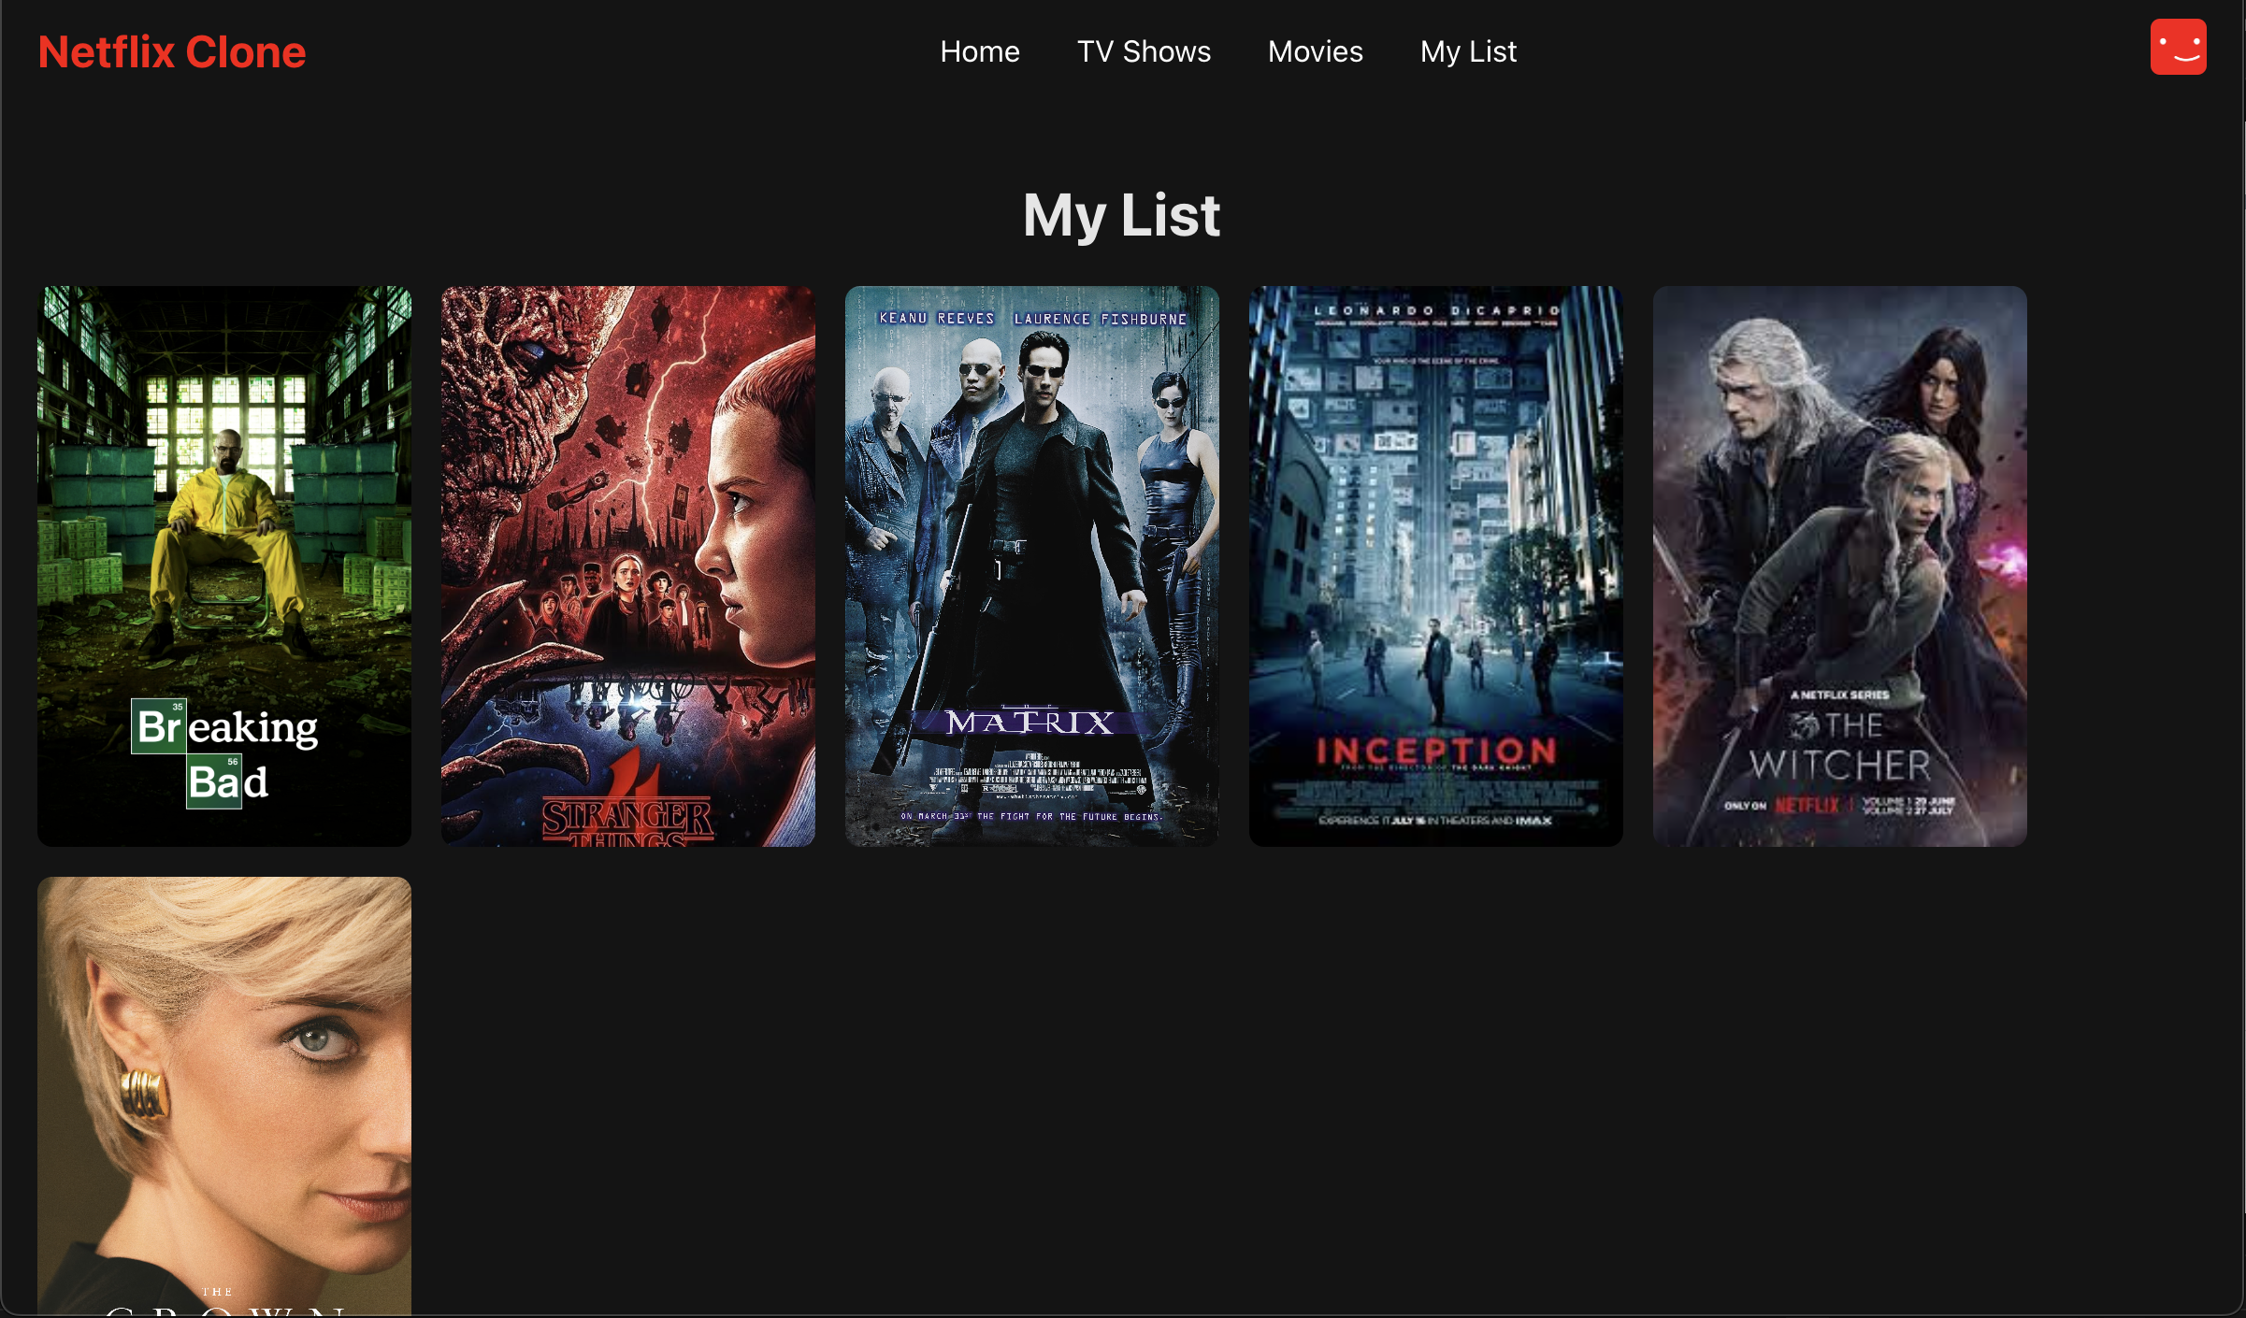

Slide 14
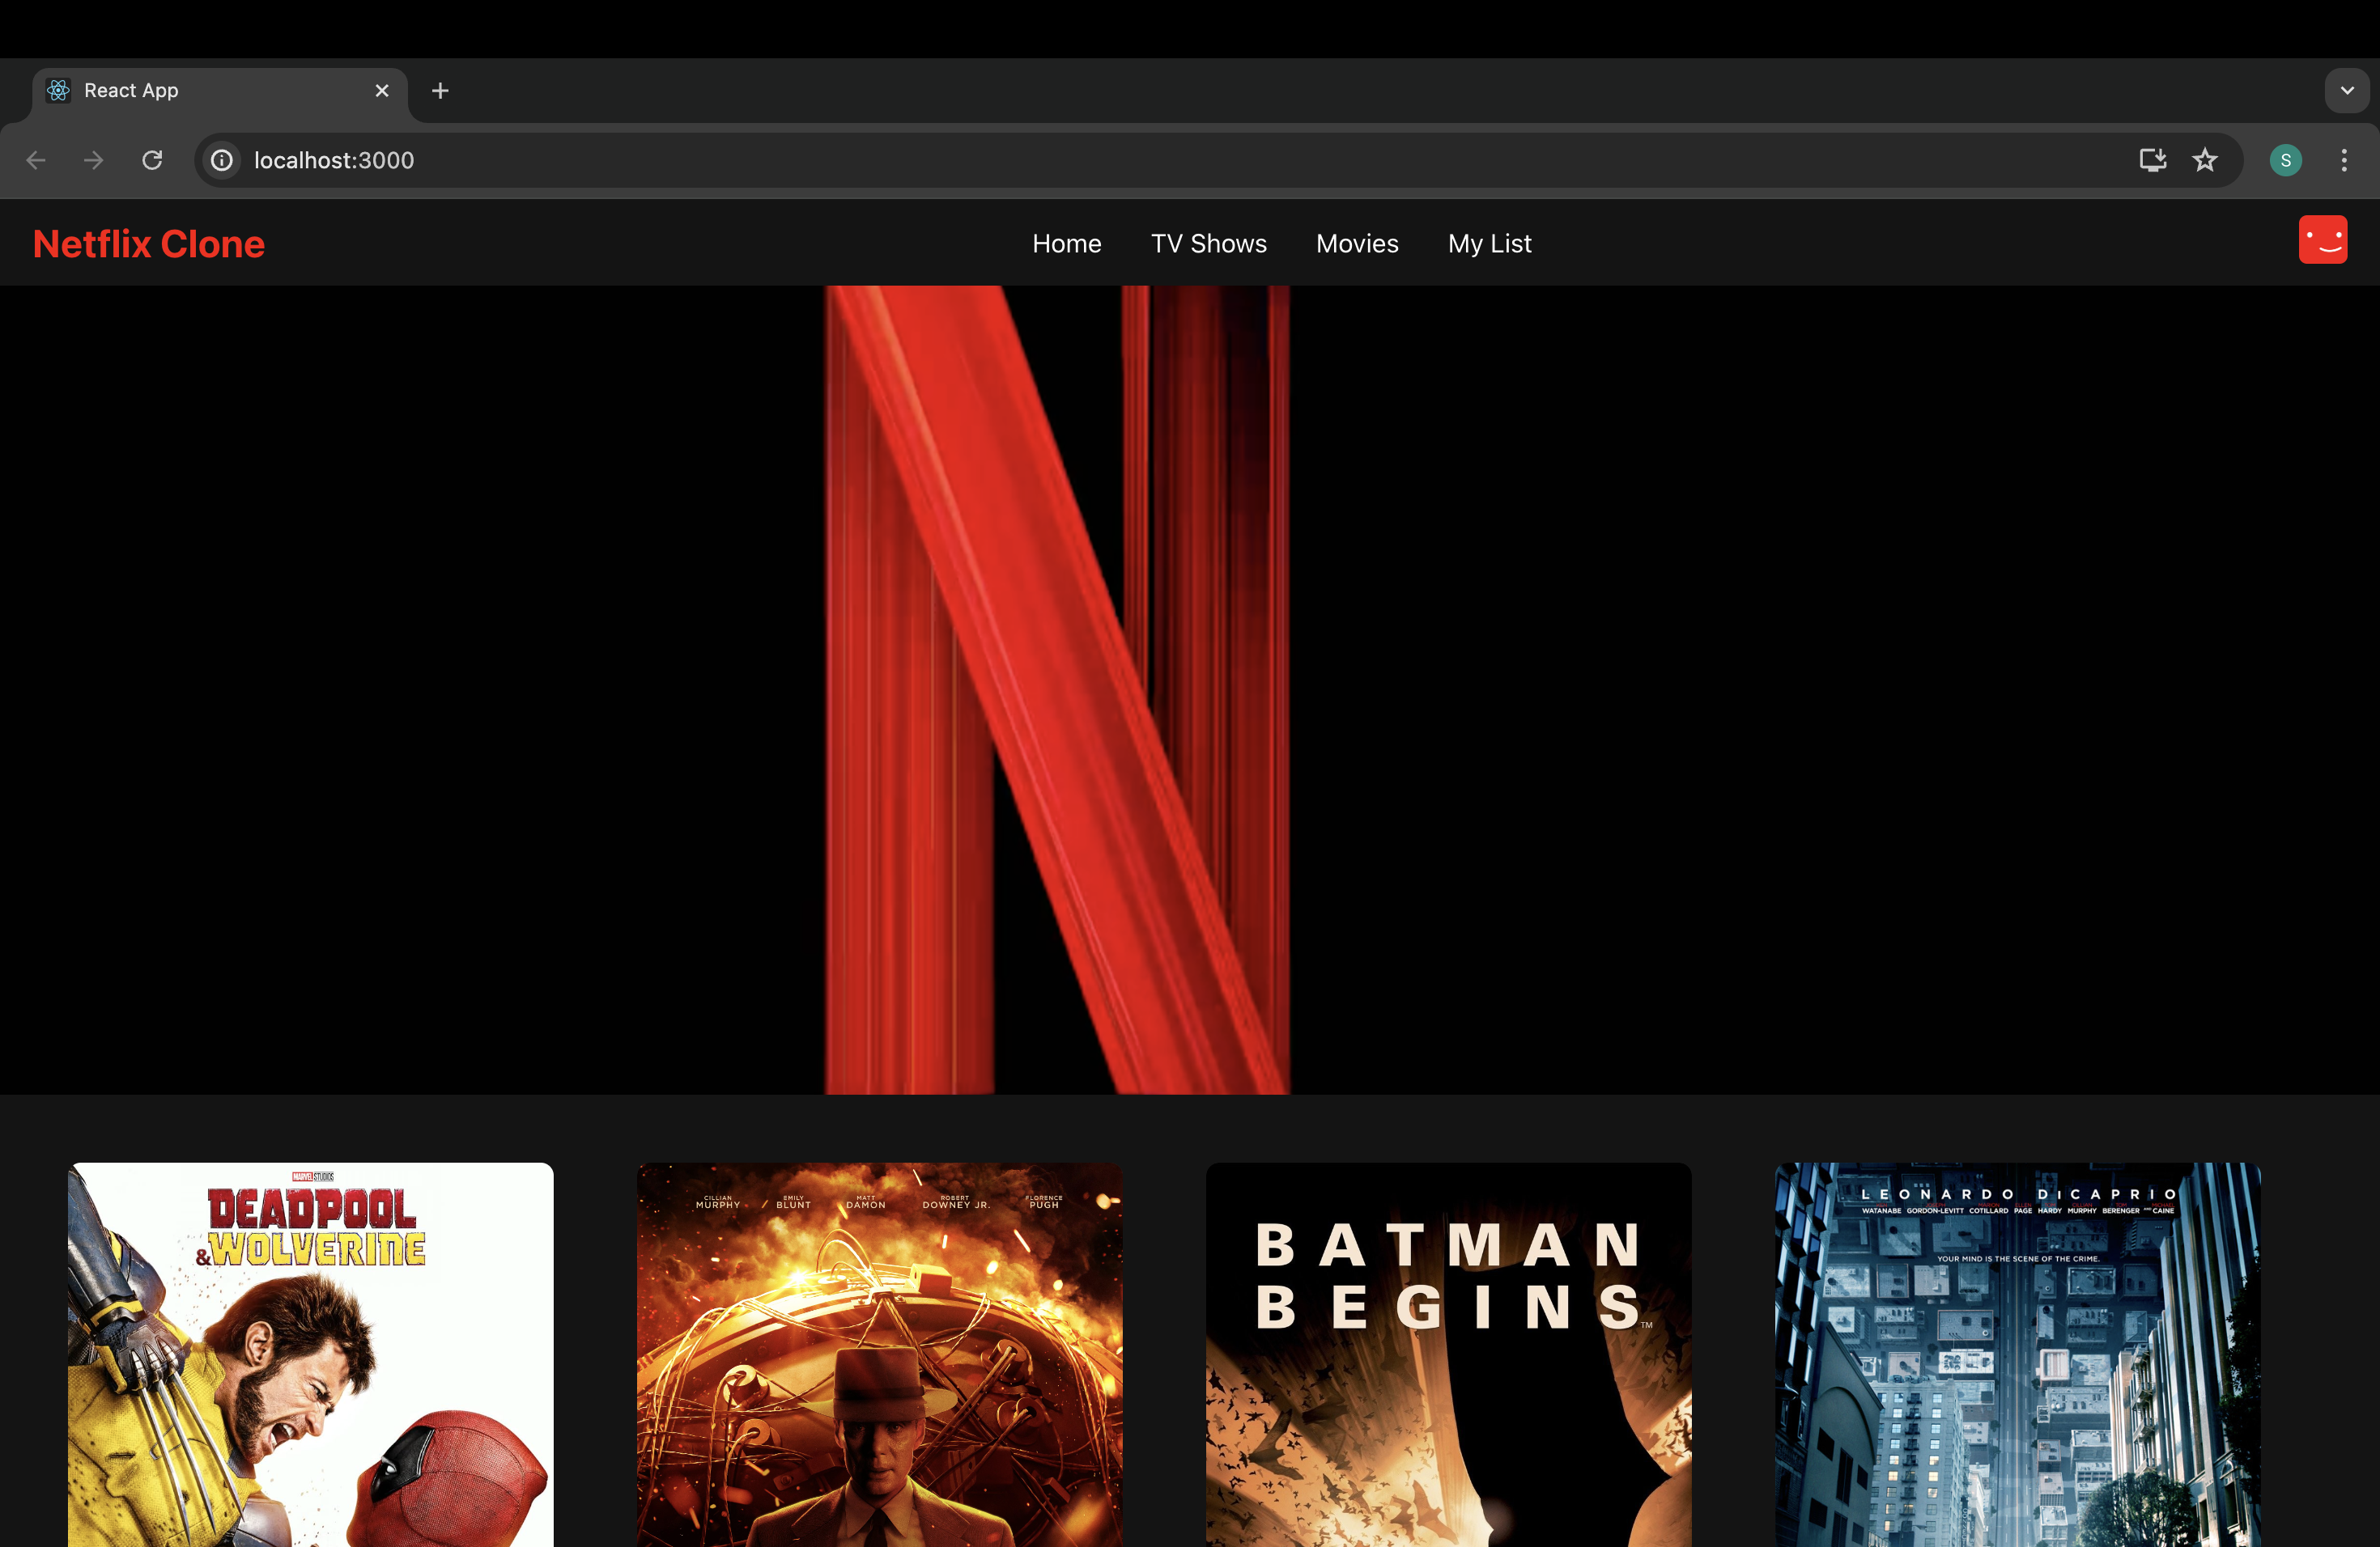
Netflix-Clone interface:

Slide 15
links
GITHUB: https://github.com/imsagar02/netflix-clone

